Slide 1
Programming analytics & data processing
Finding Best Dating Match in optimal time
Team Members:
Smriiti Singhal
Yue Sheng
Yazhuo Zhang

Slide 2

Goal
Online Dating Website
Recommends- a list of potential best matches
First meeting in real life
Predict the best time to make choice- to have highest probability to find the best matched person

Slide 3

User Interface
Input fields
Input user information
Database
~ 200 people dummy dataset

Slide 4
User Interface- input fields Tell us something about you…
First Name
Last Name
Gender- Male, Female, other
Age-
Where do you primarily live?
- Country
- City
Nationality
Personality- Introvert, extrovert, ambivert
Marital status- single, married, remarried,
separated, divorced, widowed
Likes- travelling, adventures, partying, pets,
others
Relationship looking for- short term, long
term, not decided

Slide 5
User Interface- input fields Tell us who are you looking for ?
Gender- Male, Female, other
Age- ____ to _____
Nationality
City-
Marital status- single, married, remarried,
separated, divorced, widowed

Slide 6

Tell us your 3 highest priority parameters …
Look in the database

Slide 7
Give an individual Base_Score to each person
If a preference match – add 1 to the score.
If a preference match which is among one of the highest priority fields – add 1.75 to the score.
Give top 15 potential best matches – based on Base_Score

Slide 8
Specific Scenario
Suppose 15 th and 16 th person have same base score- TIE
Tie Breaking
Algorithm
More weightage to some input fields

Slide 9
variables of uncertainty
1. Impression Score- obeys Normal Distribution
impression_score = scipy.stats.norm.rvs(loc=20, scale=5)
final_score = base_score + impression_score

Slide 10
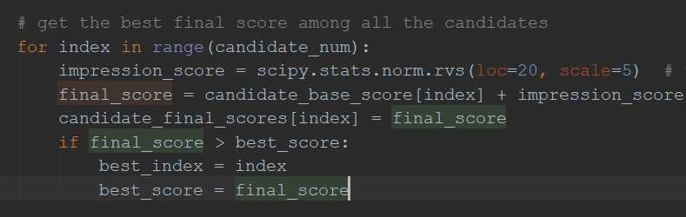
Code Snippet

Slide 11
2. Probability of person chosen by someone else- obeys linear pattern
= 0.05 * time lapsed
Prob (chosen)
Time lapsed

Slide 12

3. Probability of rejecting bcuz tired of waiting/loose interest-
obeys exponential pattern
Prob (tired of waiting)
Time lapsed

Slide 13
failure_prob = 0.05
+
0.05 * time_lapsed
+
0.05 * math.exp(time_period since meeting)/math.exp(num.of people to meet)

Slide 14
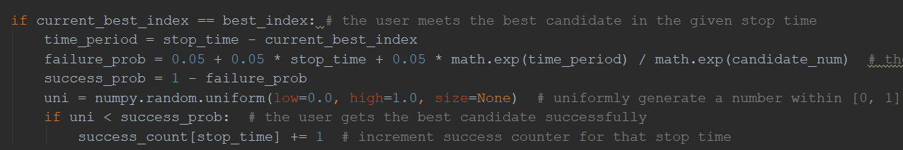
Code Snippet

Slide 15
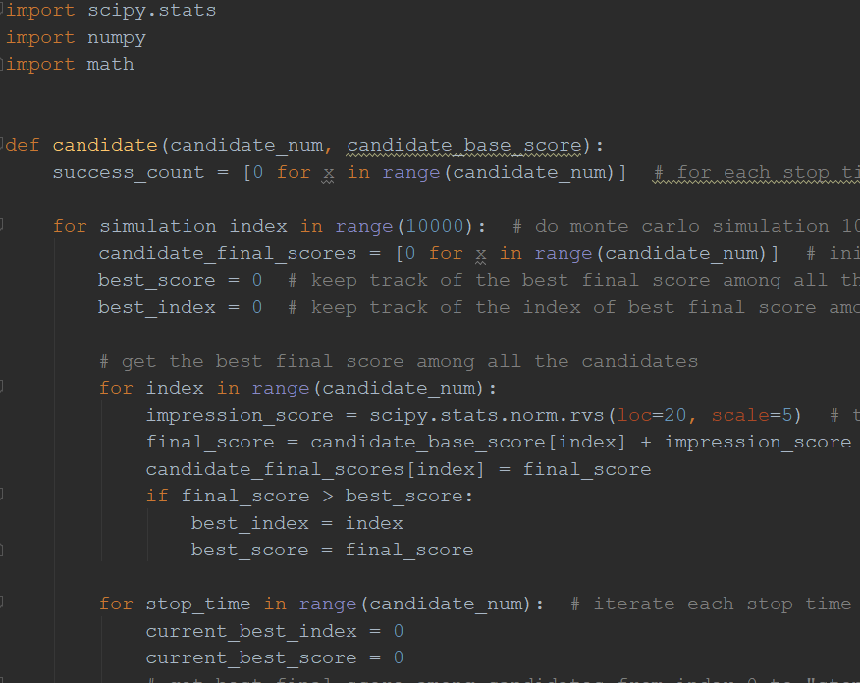
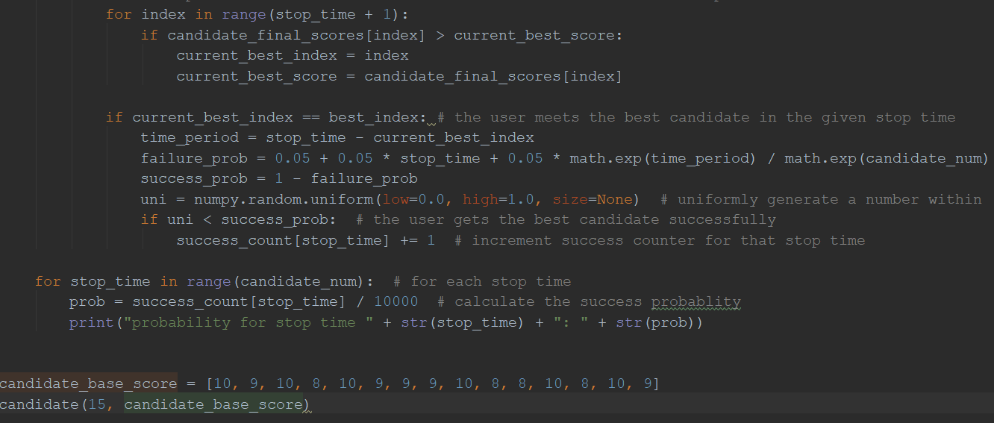
Applying Monte Carlo Simulation Simulating the code 10,000 times

Slide 16
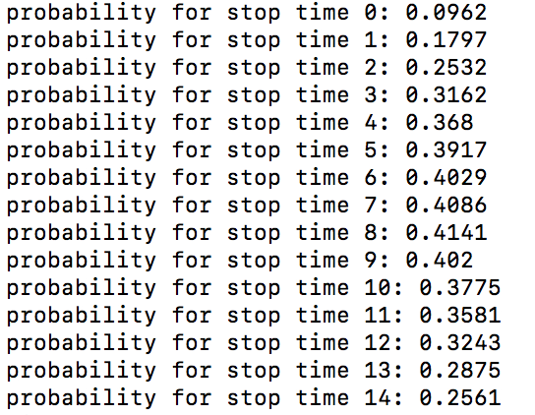
Make decision at 9th person.

Slide 17
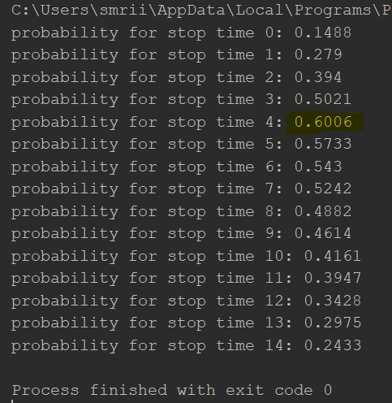
Make decision at 5th person.

Slide 18
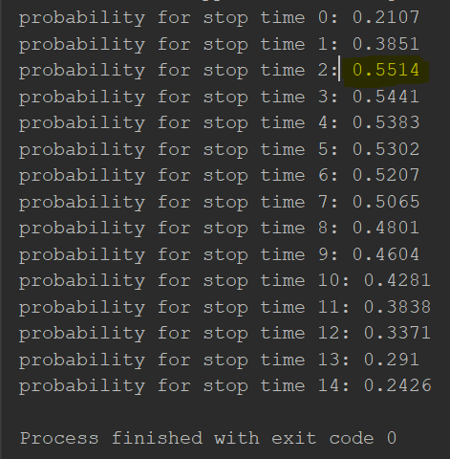
Make decision at 3rd person.

Slide 19
Other Parameter To Be Included
How the 15 potential best matches given by online website- matches with other people in the database.
Scores & number of matches
If a person’s position is above average- prob (wait for long) -> decreases
If a person’s position is below average- prob (wait for long) -> increases

Slide 20
Thank you… ☺☺

